Slide 1
VR Presentation
Save Gotham!
Done By: Team One

Slide 2
Table Of Contents
01
02
03
Objectives
Theme
Game Instructions
04
05
06
Innovation / Creativity
Game Demo
Contributions

Slide 3
Objectives
Raise Awareness
Cultivate
Learn
Educate
About the importance of recycling
Proper and correct recycling habits
Through playing and fun
Users on different recycling procedures
Aligned with Singapore’s goal of achieving 30% domestic recycling rate by 2030

Slide 4
—Author: Raph Koster
“That's what games are, in the end. Teachers. Fun is just another word for learning”

Slide 5
Theme
RECYCLING TO COMBAT CLIMATE CHANGE!

Slide 6
Theme - Recycling
According to 2020's national recycling data from NEA, the domestic recycling rate stands at 13 per cent - a 10-year low (NEA, 2021)
3 in 5 Singaporean households recycle (NEA, 2021)
40% of all items placed in the recycling bins cannot be repurposed due to food and waste leakage or are simply non-recyclable

Slide 7
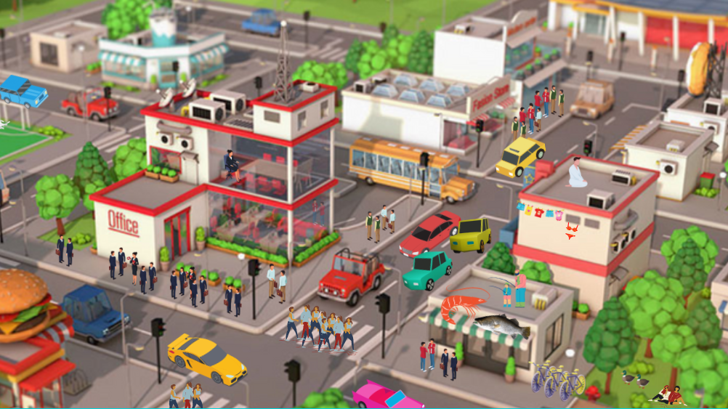
Notes:
Once upon a time, there was a city called gotham. The city was a busy trade hub, known for its bustling crowd. Gotham had the best restaurants, and all the big companies were situated there. Its accessibility was one of the reasons why everyone wanted to live in gotham. Moreover, as you guys know, at night, Gotham is the city of the BATMAN.

Slide 8
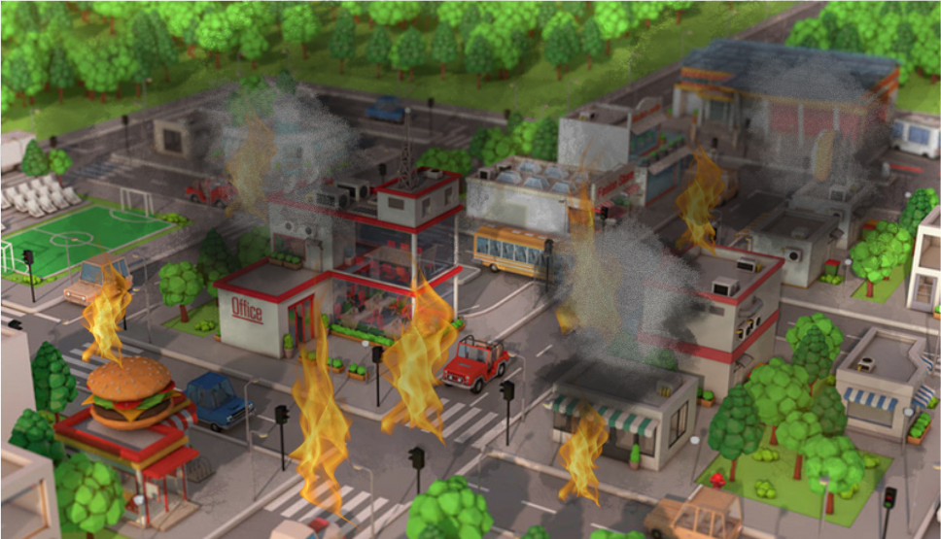
Notes:
However, one day, the owner of the seafood store contracted covid20. At night, the owner was escorted away for quarantine. Words spread like wildfire and soon everyone took their belongings and evacuated from the city.
The once buzzling city was left in shambles. That day, people from neighboring towns could see the buildings burning in gotham.
As the dust cleared, the trade hub known as gotham city was no more.. Gotham is a shadow of its past. It is now up to us, the players to restore the city!

Slide 9
Saving Gotham!
Notes:
How do we save gotham? Its simple, by playing our game, Saving gotham!

Slide 10
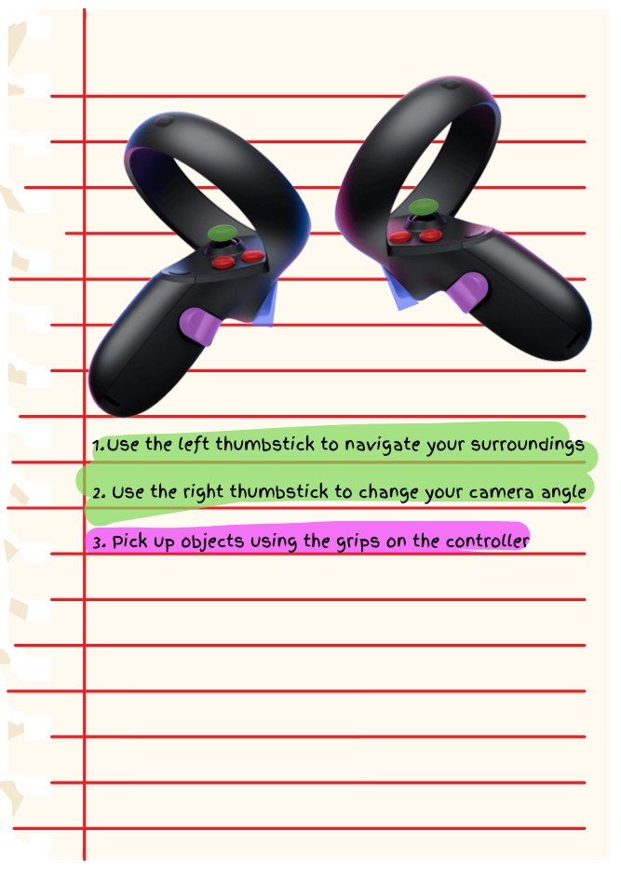
How to Play
Navigate around the city using the controllers
Detailed controls provided in-game
Notes:
So how can we play the game? Basically, we use our oculus rift to navigate around the city. We mapped all the movements to individual keys on the controller so that you can play the game smoothly on all oculus devices. Do not worry too much about it, detailed control instructions will be provided in game

Slide 11
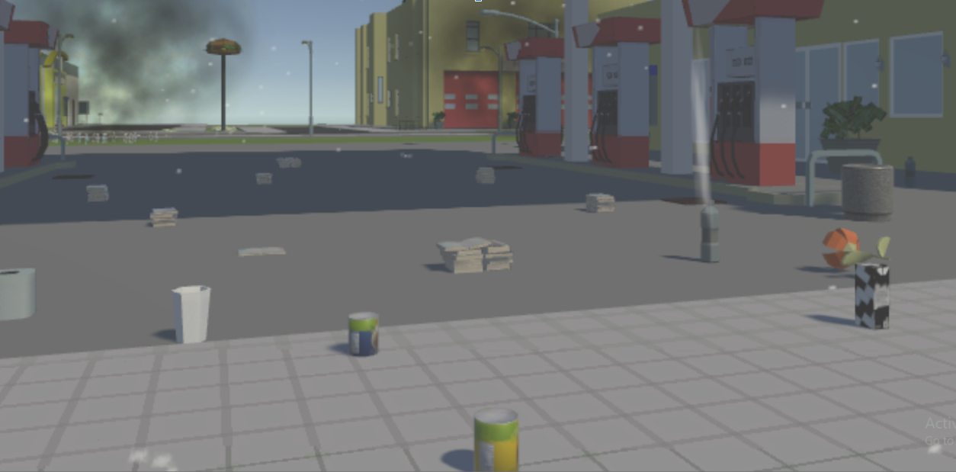
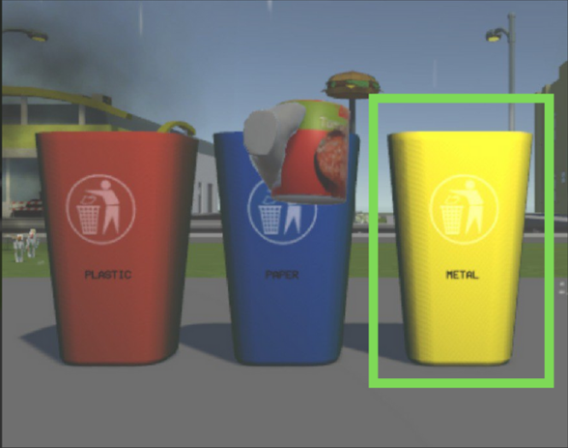
How to Play
[Insert picture of bins]
There will be 3 types of recycling bins: Plastic, Metal and Paper
Take the trash to the right bin and throw it in.
Notes:
There are an assortment of rubbish including old books, cans, plastic bottles and newspapers in gotham city. Basically what we have to do is to dispose of the rubbish. How do we do that? We shall see in the next slide!

Slide 12
How to Play
[Insert picture of bins]
There will be 3 types of recycling bins: Plastic, Metal and Paper
Take the trash to the right bin and throw it in.
Notes:
There are 3 types of recycling bins for plastic, metal and paper. Take the trash to the right bin and throw it in

Slide 13
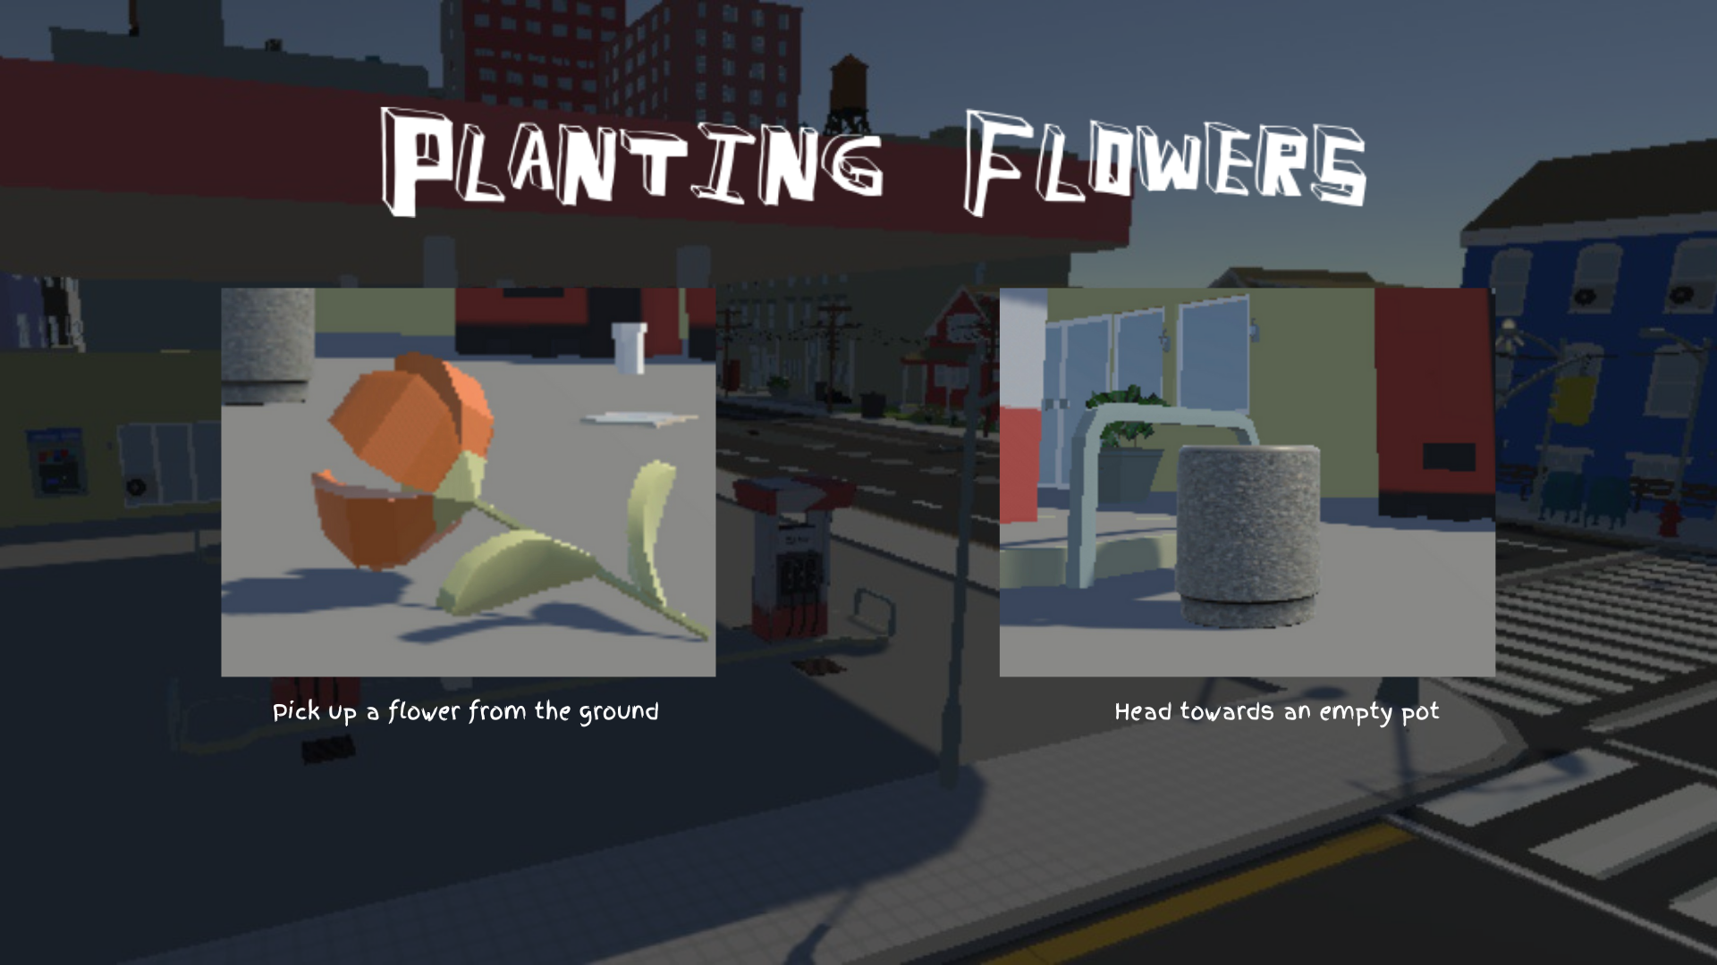
How to Play
[Insert picture of bins]
There will be 3 types of recycling bins: Plastic, Metal and Paper
Take the trash to the right bin and throw it in.

Slide 14
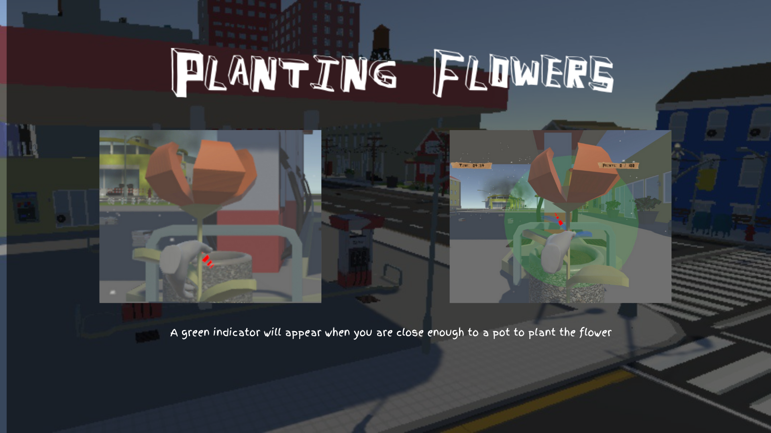
How to Play
[Insert picture of bins]
There will be 3 types of recycling bins: Plastic, Metal and Paper
Take the trash to the right bin and throw it in.

Slide 15
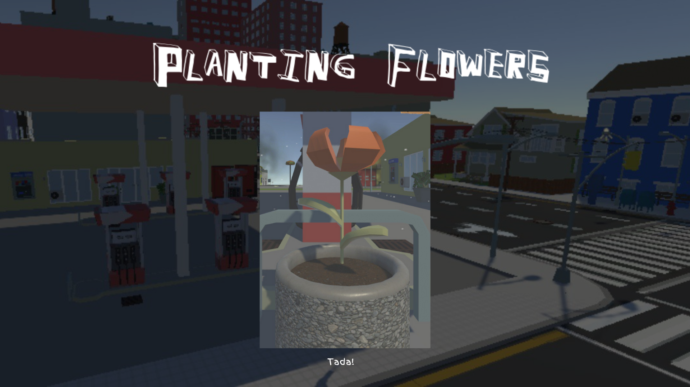
How to Play
[Insert picture of bins]
There will be 3 types of recycling bins: Plastic, Metal and Paper
Take the trash to the right bin and throw it in.

Slide 16
Scoring System
Starts with 0 points and given a time limit of 5 mins
Gain 10 points for every trash disposed correctly
Gain 20 points for every flower planted
Lose 10 points for every trash disposed incorrectly
Game ends when the time limit is up
Player wins by accumulating 200 points before the time limit is up

Slide 17
Innovation & Creativity
01
02
03
04
Rain, Smoke & Lighting reflects Environment Change
Interactable Objects (Plastic, Paper & Metal)
Planting to beautify city
Open Closed Principle & Liskov Substitution Principle
Notes:
Thank you Luo Hao. Next I will talk about the innovation and creativity of our game. We have 6 factors to talk about here. One, the environment change, two, the interactable objects, 3 the planting of flowers, 4 the design patterns that we used

Slide 18
Innovation & Creativity
05
06
Leaderboard encourages social aspect of the game
Easter eggs
Notes:
5 the leaderboard implementation and lastly allowing players to discover easter eggs

Slide 19
Environment Change
1st Stage
Points: Low
2nd Stage
Points: Medium
3rd stage
Points: High
Heavy Rain
Multiple Smoke
Dark environment
Light Rain
No Smoke
Slightly Darker environment
No Rain
No Smoke
Bright environment
Notes:
First, the environment consists of 3 stages that changes depending on the number of points the player has. For the 1st stage, the player will experience heavy rain, multiple smoke in the area and a dark environment. The 2nd stage as the player earn more points, will experience light rain, no smoke and a slightly darker environment. As for the final stage, the player will experience no rain, no smoke and bright environment. These changes in the environment is to enhance the perception that recycling items do make the environment better.

Slide 20
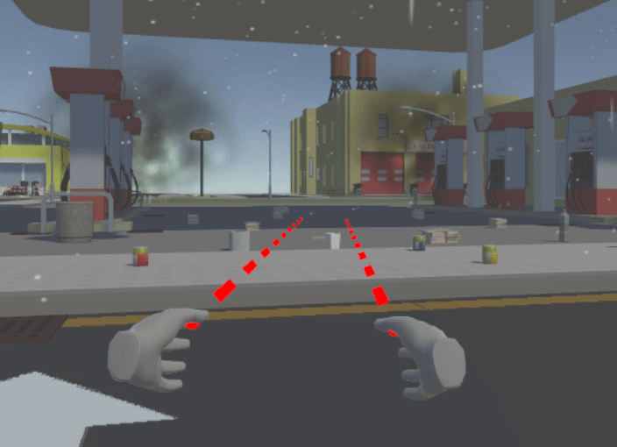
Rain Implementation
Rainfall Particle System
Made to follow vr camera
Render mode set to stretched billboard (Long cylindrical rain particles)
Collision set and applied every layer (Realistic)
RainMist Particle System
Similar to rainfall particle system but particles is much smaller to simulate the mist effect
Notes:
Let me briefly describe how the rain and smoke is implemented. For the rain implementation, we use two particle systems, rainfall and rain mist particle system. In the rainfall particle system, it is made to follow the vr camera. The render mode is set to stretched billboard to simulate long cylindrical particles. And most importantly, collision is set to collide with objects as seen in the image when the particle hitting the floor. For the rain mist particle, it is implemented very similar tot ge rainfall particle system but the particles are much smaller and circular to simulate the mist effect.

Slide 21
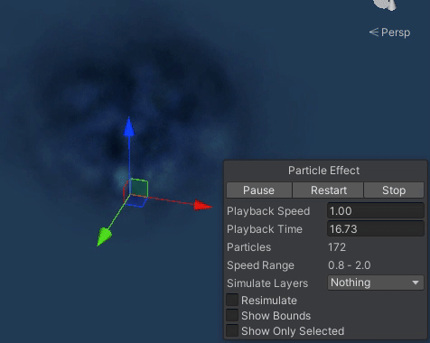
Smoke & Lighting Implementation
Smoke Particle System
Particles emitted from a hemisphere (Outward emission)
Color over lifetime is set such that particles start off grey and fades in opacity over time
Lighting
Implemented with a grey UI canvas in front of player
Lighting intensity set by adjusting alpha values of UI canvas
Notes:
Next is the smoke implementation. Here, the particles are emitted from a hemisphere to simulate an outward emission and color over lifetime is set such that the particles start off grey and fades in opacity over time. For the lighting implementation, we use a fake implementation whereby a grey UI canvas is placed in front of the player and the lighting intensity is adjusted by modifying the alpha values of the UI canvas.

Slide 22

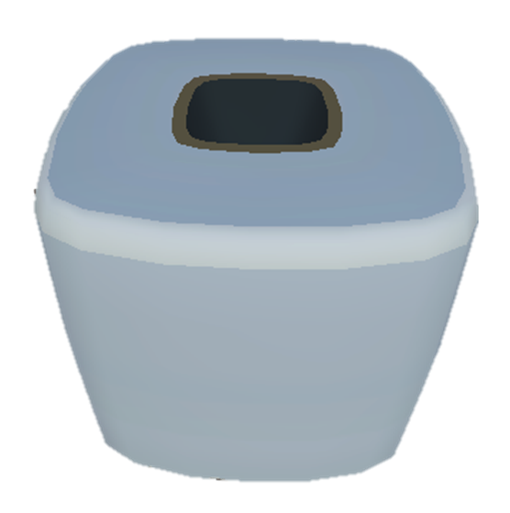
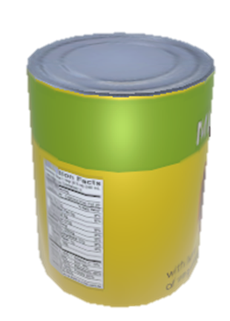
Interactable Objects (Recyclables)
Plastic
Paper
Metal
Specular Workflow
Smoothness: 0.5
Metallic Workflow
Metallic: 0
Smoothness: 0
Metallic Workflow
Metallic: 0.5
Smoothness: 0.5
Notes:
Next, I will touch on the interactable objects implementation. Here, we use different PBR to create different recyclables. Here, plastic objects uses specular workflow with smoothness set to 0.5. Paper objects uses metallic workflow with metallic and smoothness set to 0 and metal objects uses metallic workflow with metallic and smoothness set to 0.5.

Slide 23
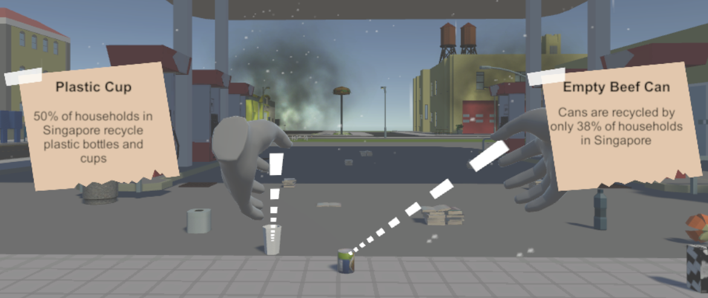
Interactable Objects (Tooltip)
On hover, a tooltip is shown to player
Tooltip consists of
Object’s name
Object’s information/trivia
Notes:
The interactable objects also show a tooltip when hovered with the VR hands. This tooltip displays the object’s name as well as the object’s info and trivia.The purpose of this is to increase player’s awareness on recycling related statistics in Singapore

Slide 24
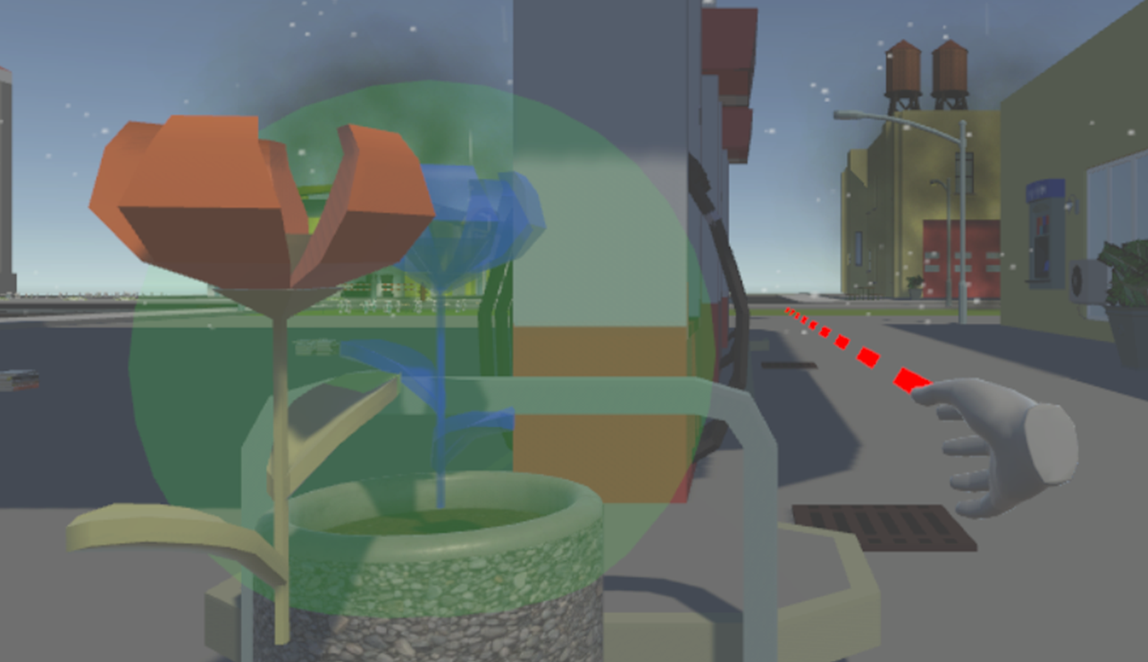
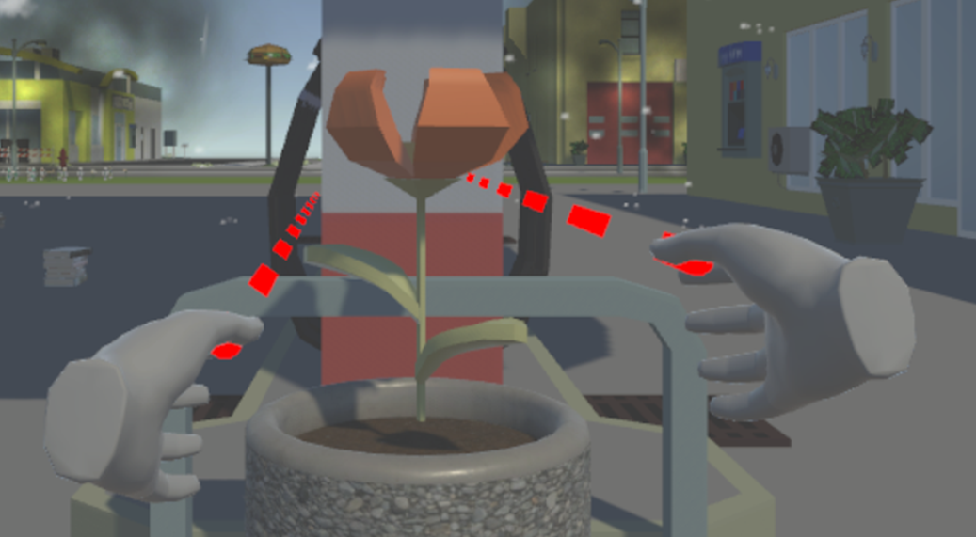
Planting flowers
More variations to the gameplay
Flowers scattered around the city can be brought to an empty pot to plant
Interactive planting
Notes:
Next, I will touch on planting flowers whose purpose is to add more variations to the recycling gameplay. Here, the player can grab flowers scattered around the city and plant it in an empty pot as illustrated by Luo Hao earlier.

Slide 25
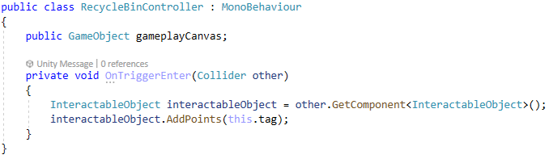
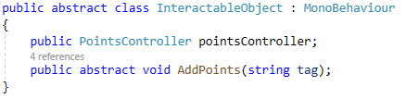
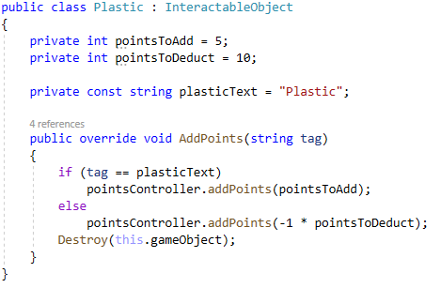
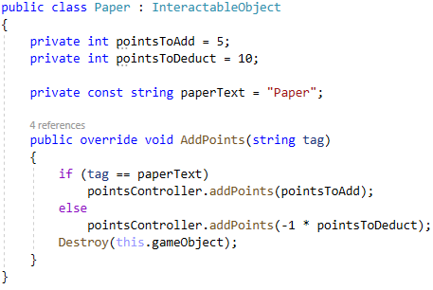
Open Closed Principle & Liskov Substitution Principle
Here, we create Plastic and Paper classes which extend from the abstract class InteractableObject
In the OnTriggerEnter() method inside RecycleBinController class, we are able to replace the derived classes mentioned above with the base class it extends from
The InteractableObject class is closed for modification but open for extension
Notes:
Next, I will touch on the design patterns that we used which are Open Closed Principle and Liskov Substitution Principle and how they are useful. Here, we create Plastic and Paper classes that extends from the abstract class Interactable Object. As the logic is implemented in the child classes, recycleBinController can simply call the parent class to execute functions that are unique to the object. Because interactableObject itself is an abstract class, it is closed for modification but open for extension. These design principles are useful as it allows us to create new interactable objects such as metal, glass, and flowers easily.

Slide 26
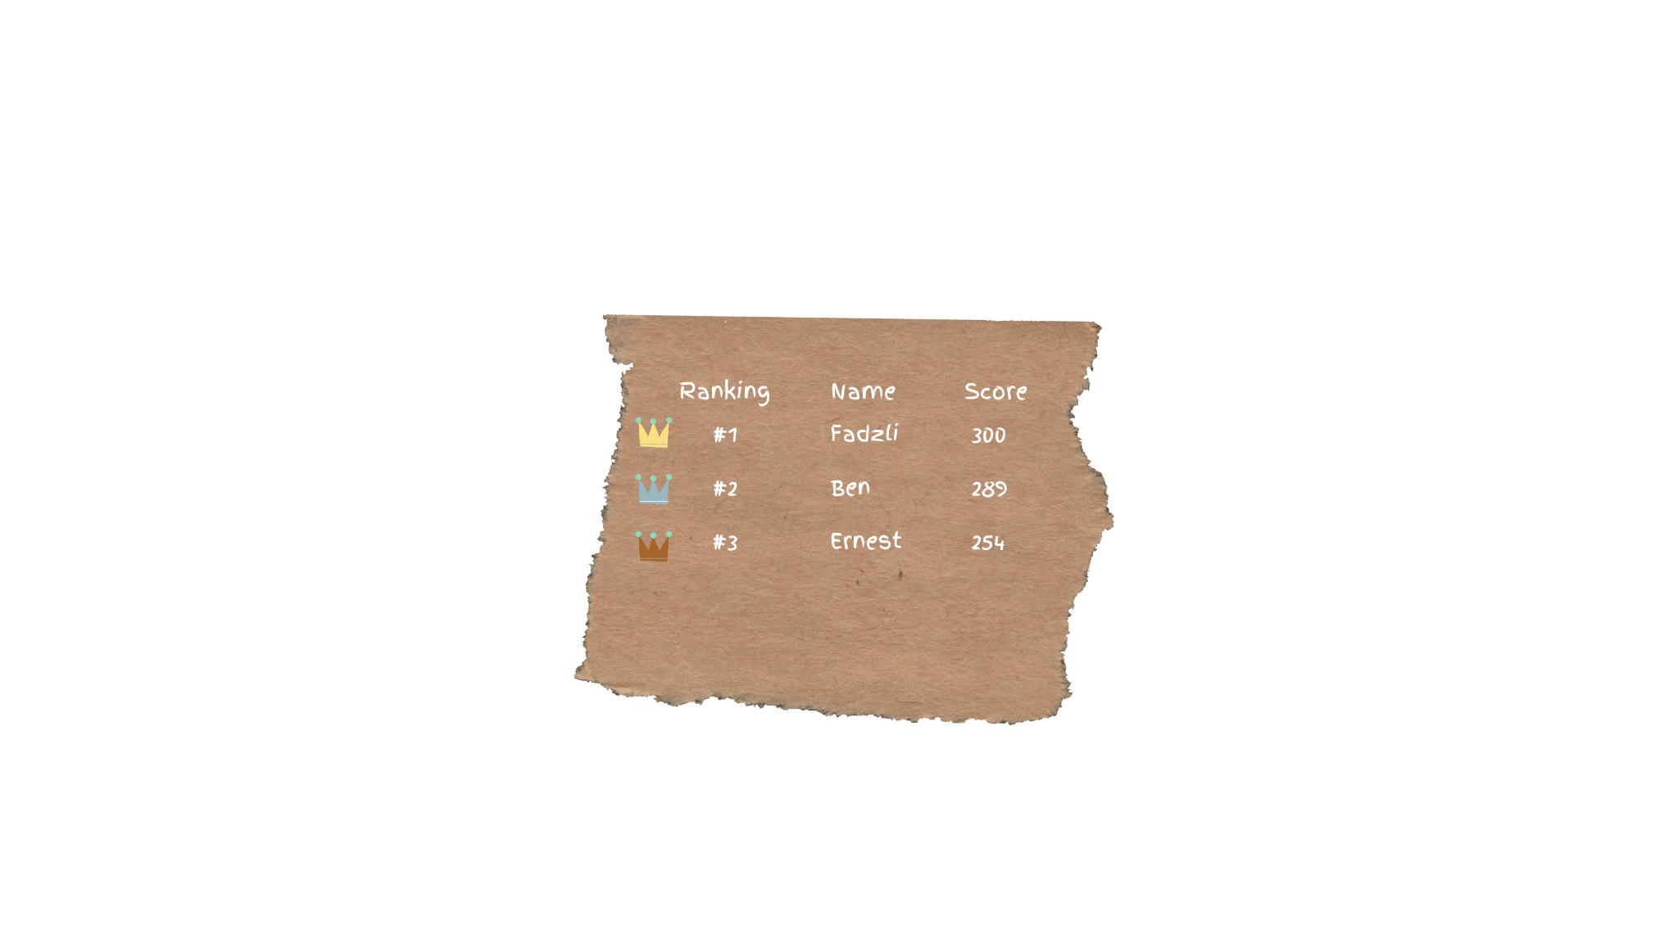
Leaderboard
Encourages social aspect of the game
Encourages collaborative learning, thus increasing levels of motivation
Competitive Spirit
Make learning a fun experience
Compete against friends
Notes:
Next, I will touch on the leaderboard. Having a leaderboard encourages the social aspect of the game which helps increase levels of motivation. It also helps to instill a competitive spirit by allowing the player to compete against friends and make learning fun.

Slide 27
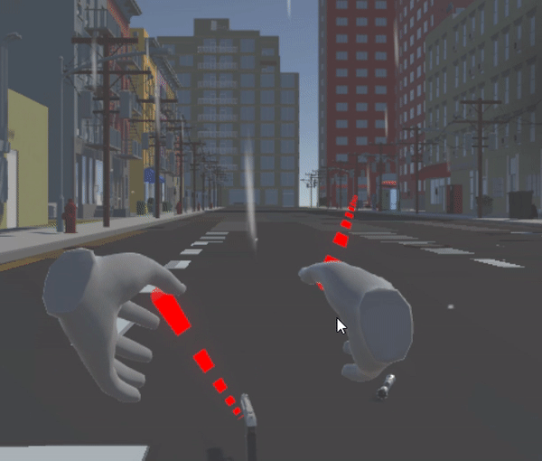
Easter Eggs
Many interesting characters visited Gotham before, will you discover the clues left behind by them?
Notes:
Lastly, to give our players a more memorable experience, we left some interesting items all over the city for you to find, including a lightsaber and a toy gun.

Slide 28
Contribution (Fazli, Ernest, Luo Hao)
Front-end Development
Environment (Ernest)
UI Design & Implementation (Luo Hao)
VR Setup & Gameplay Mechanics (Fazli)
Back-end Development
Firebase Database for Leaderboard (Ernest)
Debug
QA Testing (Luo Hao)

Slide 29
Contribution (Wanru, Rachel)
Storyboarding
Game-flow
Storyline
Presentation slides
Features of game
Report
Documentation of methodologies used
Video editing and flow
Trailer

Slide 30
Upcoming Plans
Expandable
Large map
Metaverse is the future
Multiplayer/Coop
Public transport
Transition between different maps as we expand the game

Slide 31
Game Demo

Slide 32
Credits
CITY Package by 255 pixel studios (City)
RainMaker by Digital Ruby (Rain)
War FX by Jean Moreno (Smoke)
Recycle Bin by Mariam Sarishbili (Recycle Bins)
Trash Low Poly Cartoon Pack by BlankfaceStanislav (Trash)
Lowpoly Flowers by chlyang (Flowers)

Slide 33
References
Andres, G. (2021, April 23). Less waste generated in Singapore in 2020, recycling rates drop due to impact of covid-19. CNA. Retrieved February 22, 2022, from https://www.channelnewsasia.com/singapore/less-waste-generated-singapore-recycling-rates-drop-239601

Slide 34
Thank you!

